Slide 1


Technical Home School
technicalhomeschool.tk
Ready to fry in technology
Presented By Kanchan Soni
(AWS Cloud Associate)

Slide 2

Agenda
Introduction
Problem Statement
Requirements
Architecture diagram
List of AWS services used
Security
Website visit

Slide 3
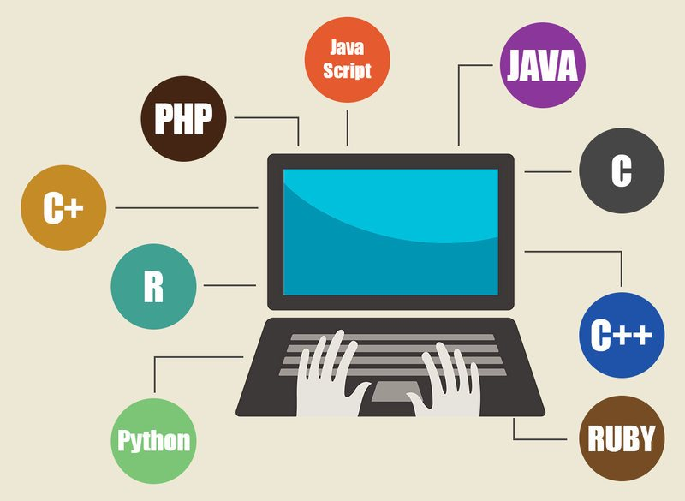
Introduction
Derived from two words Technical + Home School.
It is a survey page to get student interest towards trending technologies.
We will use AWS services to set up their environment.
Tag line - Ready to fry in technology

Slide 4

Problem Statement
Institute provides an invaluable space for personal development to the students for that they want to receive information from students of India about which technologies students are interested in and store into the database for analyzing technologies trends for arranging online classes. So that students can establish their technical skills and achieve their goals in a minimal cost.

Slide 5

Requirement
Client has 3 basic requirements :
Data /information about students and their technologies interest.
Low set up cost in AWS.
Data should be secured.

Slide 6
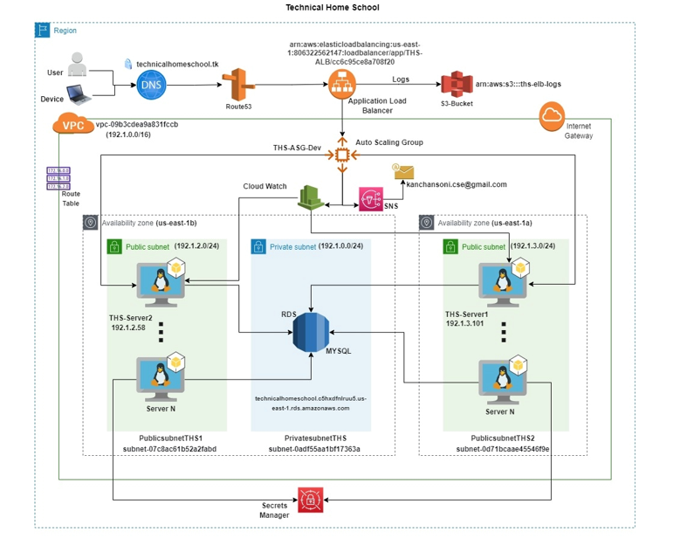
Architecture Diagram

Slide 7
List of AWS services used
VPC( Virtual Private Cloud )
RDS(Relational Database Service)
EC2(Elastic Compute Cloud)
ALB(Application Loan Balance)
ASG(Auto Scaling Group)
S3(Simple Storage Service)
IAM – User
Certificate Manager
Secrets Manager
Route53
SNS(Simple Notification Service)
Cloud Watch

Slide 8

Security
Services used :
ACM(Amazon certificate manager) for SSL
Secretes manager
DB created in private subnet & not accessible publically
Security Groups - only allowed authorized traffic

Slide 9

Difficulties and resolution
Manual Start – nohup
Learning Shell Script /Cron Tab
Auto Scaling –Target tracked policy
Change the policy-Simple Scaling
DB password hard coded
Secrets manager
botocore.exceptions.NoRegionError:
Assume role

Slide 10

Benefits
New business proposal based on this POC.
We may get 24/7 Support service.
Primary support providers.

Slide 11


Slide 12


